Slide 1
軟體工程設計 W7
許庭瑋、陳君翰、洪世彬、劉玠均、楊昕叡、林俊佑
2023/11/2

Slide 2
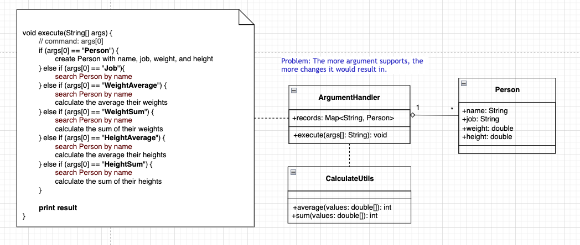
HW0 Initial Design
Notes:
ConvertingComparator<S, T>, DefaultConversionService, 8 default converters

Slide 3
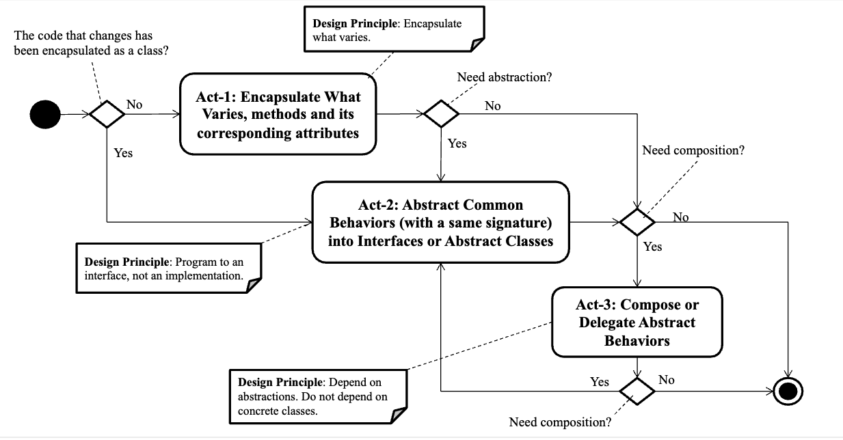
HW0 Design Process
Command 可能增加, Person 可能為 Null, CaculatorUtils 可以有多種計算方式, 三者做封裝
拉出 Command, AbstractPerson, Caculator 作為抽象介面
組合Command 和 AbstractPerson 兩個抽象介面, 且指派 Caculator 完成計算
Notes:
ConvertingComparator<S, T>, DefaultConversionService, 8 default converters

Slide 4
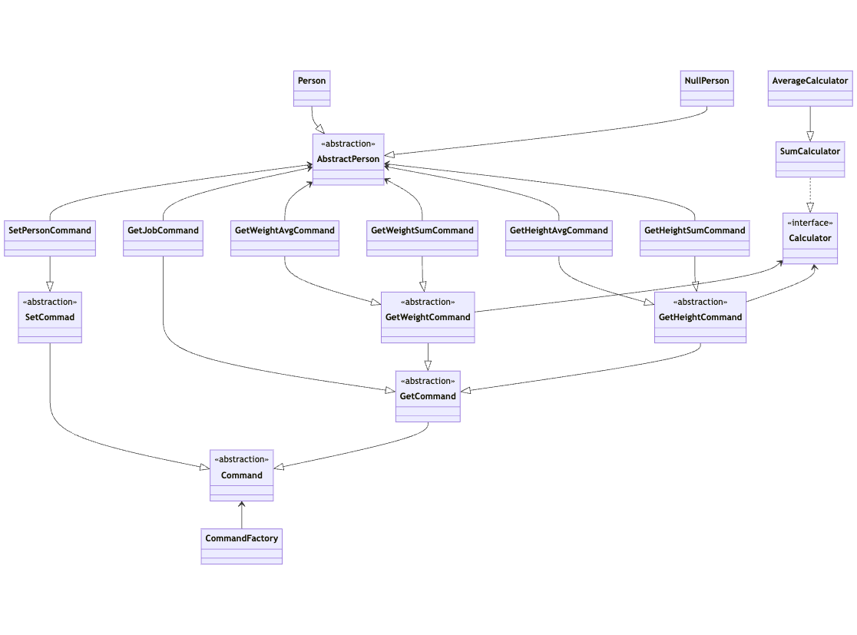
HW0 Final Present
LINK: 原始 SVG
Notes:
ConvertingComparator<S, T>, DefaultConversionService, 8 default converters

Slide 5
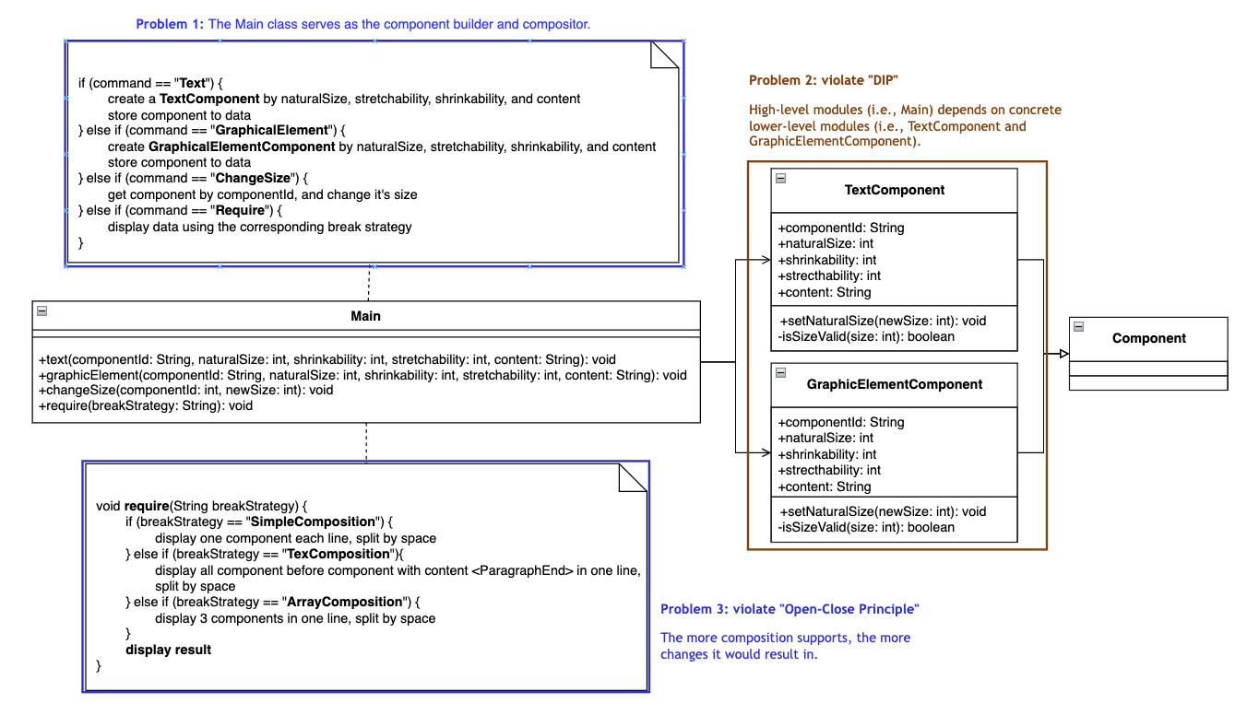
HW1: Initial Design
Notes:
ConvertingComparator<S, T>, DefaultConversionService, 8 default converters

Slide 6
Problems of the initial design
Problem 1. The Main class serves as the component builder and compositor
Act 1-1: Delegate add/set component operations to RecordHandler
Act 1-2: Use CompositorFactory to get compositor in runtime
Problem 2. Violate “DIP”. High-level modules (i.e., Main) depends on concrete lower-level modules (i.e., TextComponent and GraphicElementComponent)
Act 2: Abstract common behaviors into Component interface. (Attributes and functions of TextComponent and GraphicalElementComponent are the same)
Problem 3. Violate "Open-Close Principle". The more composition supports, the more changes there will be in function require().
Act 3. Delegate compose() behavior to Compositor interface.

Slide 7
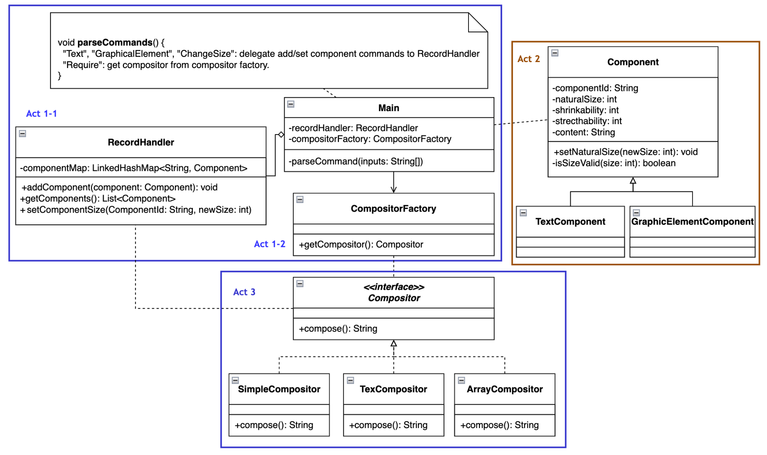
HW1: Refactored Design
Notes:
ConvertingComparator<S, T>, DefaultConversionService, 8 default converters

Slide 8
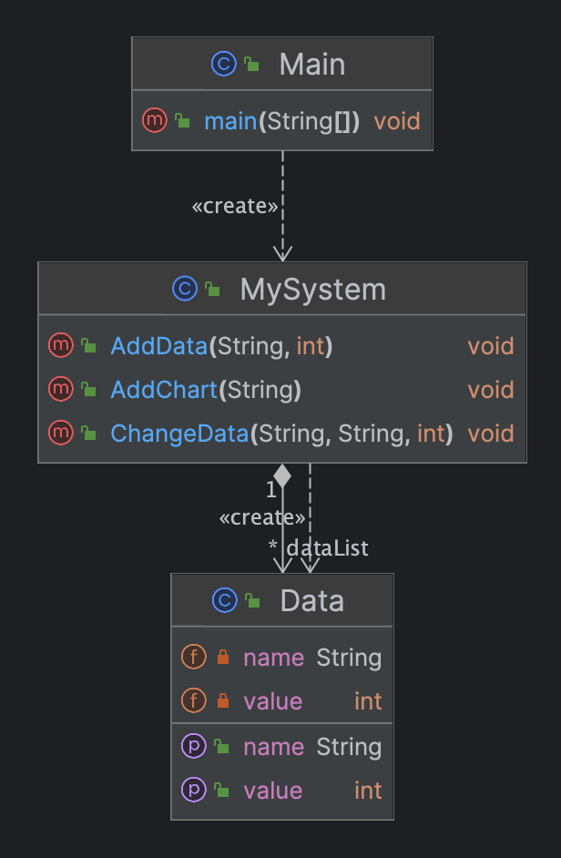
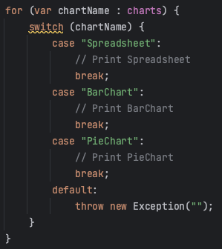
HW2 - Initial Design
Problem: If different kind of chart is added, MySystem should be opened and modified.
Notes:
ConvertingComparator<S, T>, DefaultConversionService, 8 default converters

Slide 9
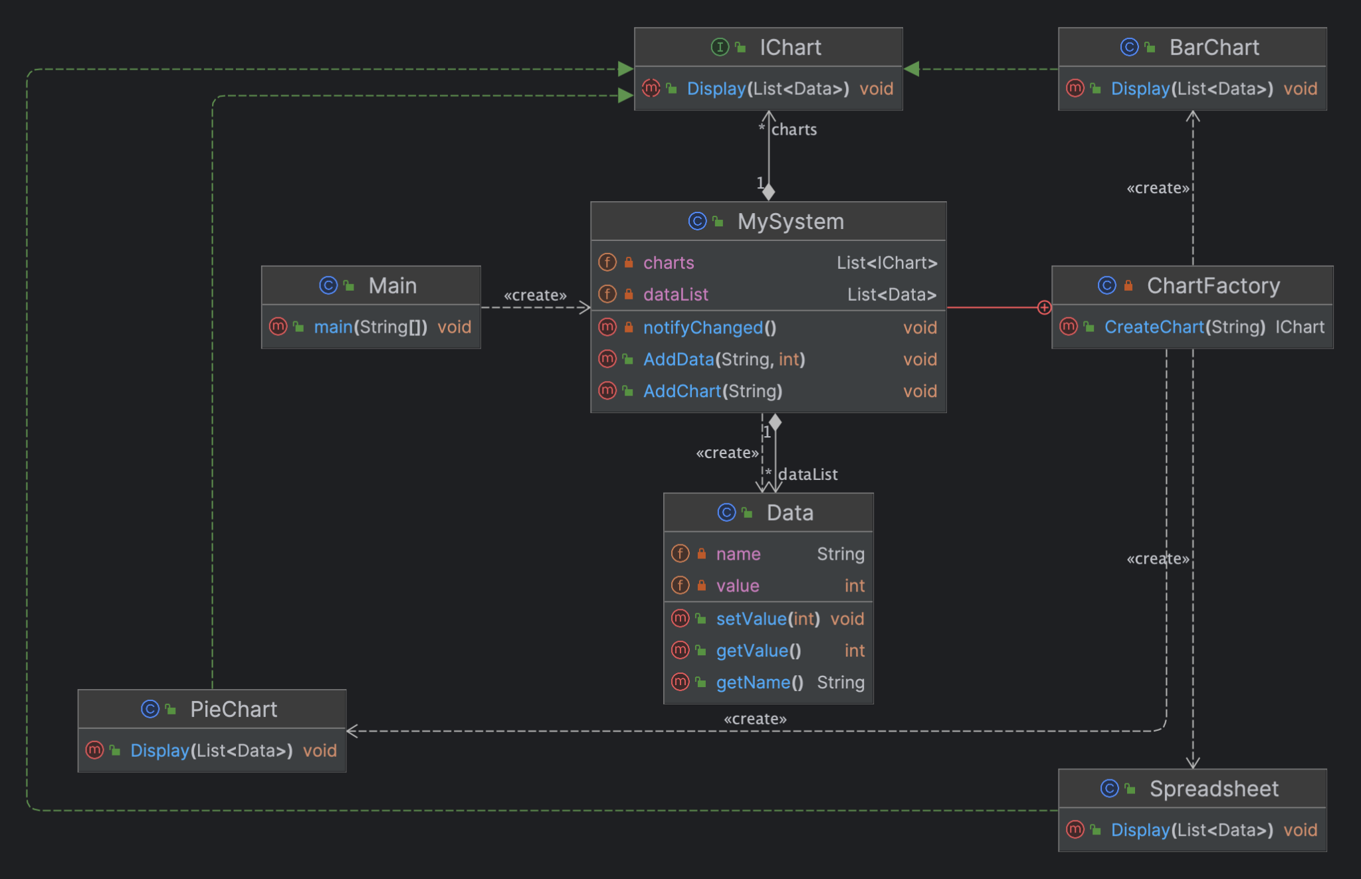

Use DIP to introduce IChart, and encapsulate chart creation in ChartFactory.
Notes:
ConvertingComparator<S, T>, DefaultConversionService, 8 default converters

Slide 10
Inner Class
Advantage
can private it, for patterns like delegation
can can use private attributes or methods of outer class
can logically group related classes within a single class, useful for encapsulation.
Disadvantage
difficult to test
need more memory
more classes, JVM may be slower when the number of inner class are too large.
Notes:
ConvertingComparator<S, T>, DefaultConversionService, 8 default converters

Slide 11
Code Tracing

Slide 12
Weekly Code Tracing Progress
 | Part | LOC
spring-core-core
許庭瑋 | DataBufferFactory.java,DataBuffer.java,DefaultDataBuffer.java | 567
楊昕叡 | TypeMappedAnnotations.java, AnnotationsProcessor.java | 520
劉玠均 | core.MethodParameter.java | 560
洪世彬 | org.springframework.core.log | 450
spring-core-aot, spring-core-cglib
陳君翰 | org.springframework.aot.hint, org.springframework.aot.hint.support | 557
林俊佑 | cglib/core/NamingPolicy + GeneratorStrategy + Predicate | 600

Slide 13
許庭瑋
DataBufferFactory
A factory for DataBuffer, allowing for allocation andwrapping of data buffers.
Is an interfece, has functions:allocateBuffer, wrap, join, isDirect
DataBuffer
Is an interfece, too. So many functions so that I can’t list here. Most of them are for reading and writing.
default write(): write the given CharSequence using the given Charset, use CharsetEncoder to decide chars, use ByteBufferIterator to iteratively create buffer and write datas in it.
Notes:
ConvertingComparator<S, T>, DefaultConversionService, 8 default converters

Slide 14
許庭瑋
DefaultDataBuffer
Implementation of DataBuffer
getNativeBuffer: get buffer include datas
indexof: return the index of the first byte matching predicate(from fromIndex to this.writePosition)
lastIndexOf: like indexof, but return the last index
setCapacity: if newCapacity > oldCapacity, move old datas in oldBuffer to newBuffer, else, move old datas between readPosition and writePosition in oldBuffer to newBuffer
calculateCapacity: return 3 types of feasible capacity: n*CAPACITY_THRESHOLD, MAX_CAPACITY, 64*2^n
Notes:
ConvertingComparator<S, T>, DefaultConversionService, 8 default converters

Slide 15
許庭瑋
DefaultDataBuffer
ensureWritable: set new capacity
allocate, getByte: just like what java.nio.Buffer do
read: duplicate the original buffer, and get data from it.
write: duplicate the original buffer, and put data in it. support writing from one or more buffers.
split: like slice for java.nio.Buffer, return a new DataBuffer sliced from original one
toByteBuffer / toString: put data to a bytebuffer/ String
ByteBufferIterator: inner class that has a buffer
Notes:
ConvertingComparator<S, T>, DefaultConversionService, 8 default converters

Slide 16
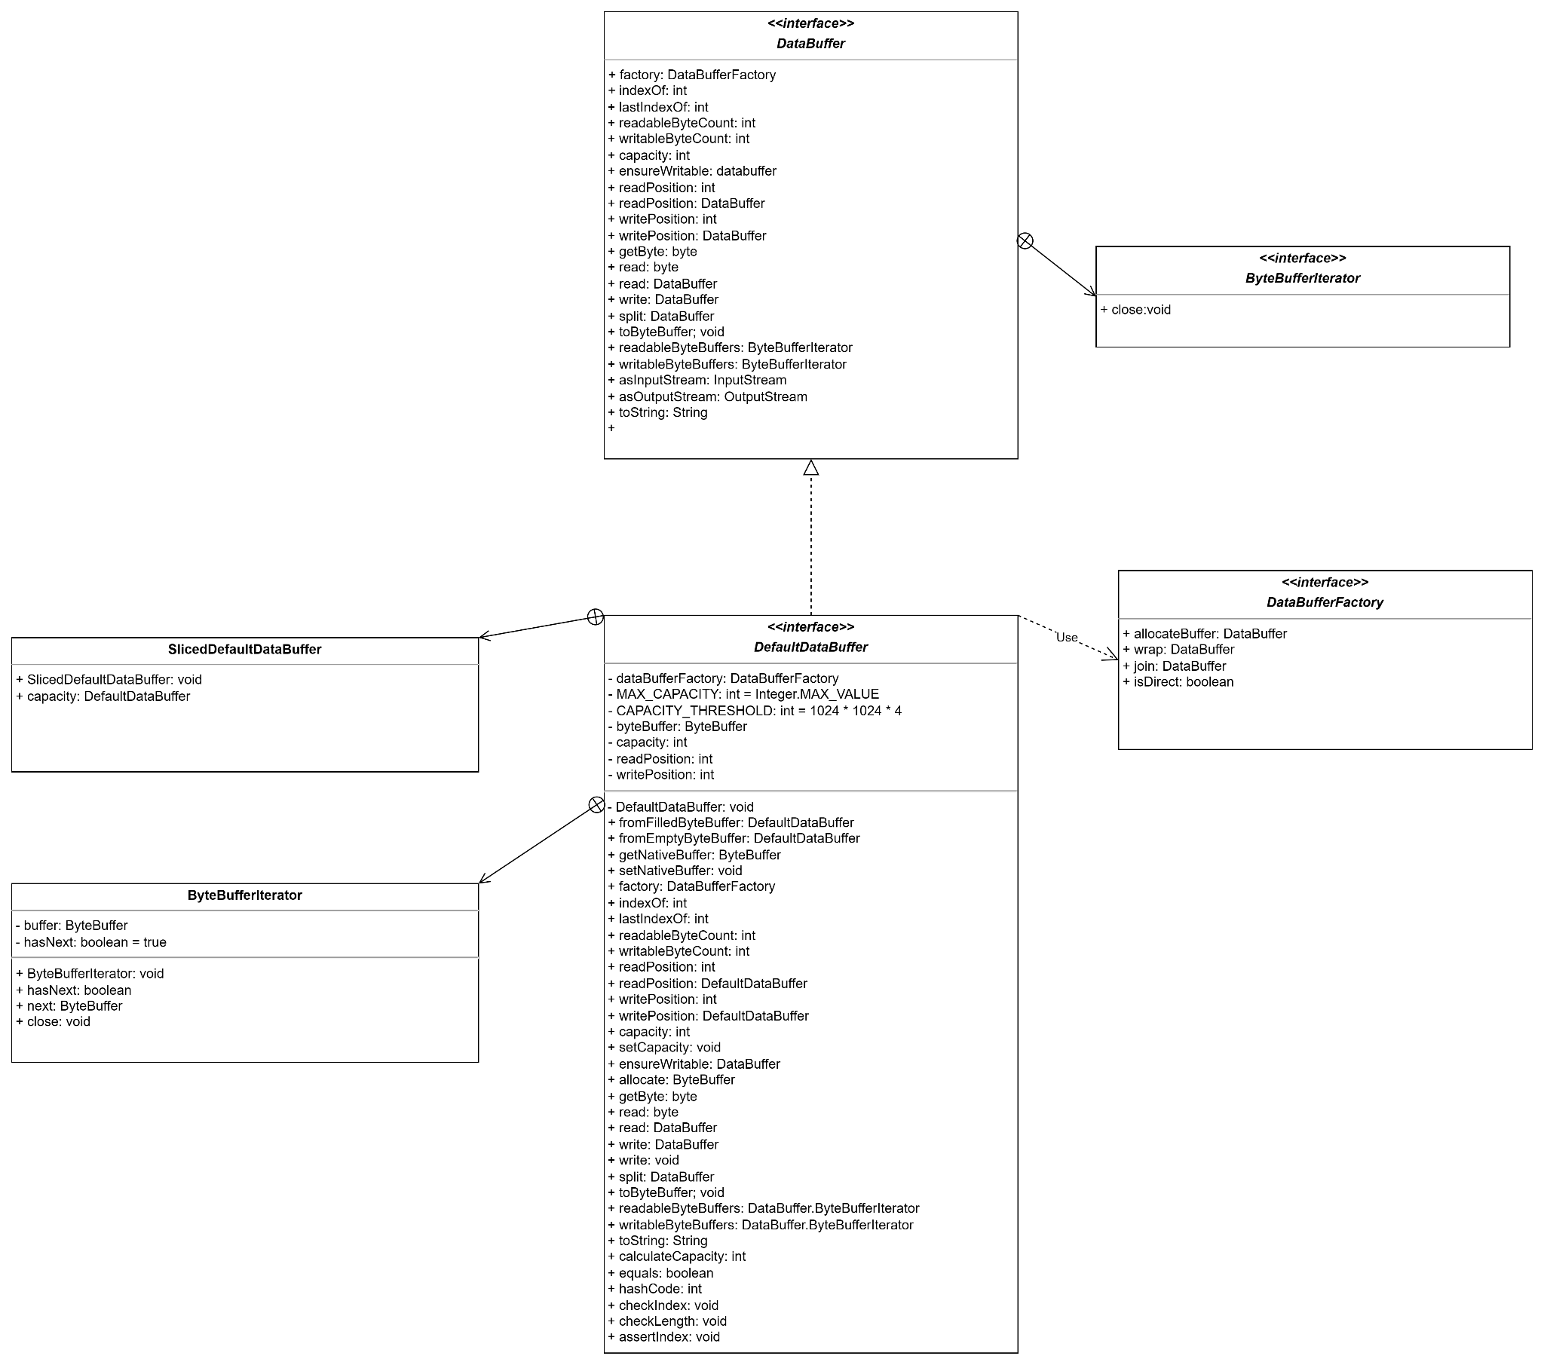
許庭瑋
UML for this week
Notes:
ConvertingComparator<S, T>, DefaultConversionService, 8 default converters

Slide 17
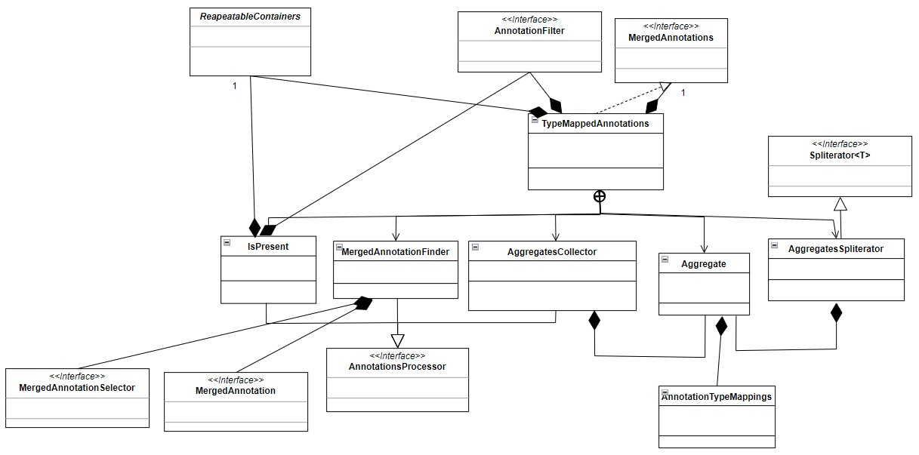
楊昕叡
class diagram: full version
Composition and inner classes are used.

Slide 18
楊昕叡
In TypeMappedAnnotations, all inner classes (include implementation of AnnotationsProcessor) are private, when public methods that use AnnotationsProcessor are called, they designate one implementation of AnnotationsProcessor, so it may follow Law of Demeter.

Slide 19
楊昕叡
get(annotationType: Class<A>): <A extends Annotation> MergedAnnotation<A>
Return the nearest matching annotation of the specified type.
scan(criteria: C, processor: AnnotationsProcessor<C, R>): <C, R> R
Do something related to an annotation or an element. For element, it scan the hierarchy of the specified element for relevant annotations. For annotation, the action depends on the type of AnnotationsProcessor. This method calls doWithAggregate(), doWithAnnotations(), and finish(), which are defined in the interface AnnotationsProcessor, so DIP are used here to interact only with the interface.

Slide 20
楊昕叡
private static final class IsPresent implements AnnotationsProcessor<Object, Boolean>
Check if an annotation is in the scanning range of AnnotationSaccner.

Slide 21
楊昕叡
private class MergedAnnotationFinder<A extends Annotation> implements AnnotationsProcessor<Object, MergedAnnotation<A>>
Find an MergedAnnotation matching the given type from annotations scanned from AnnotationScanner.

Slide 22
楊昕叡
private class AggregatesCollector implements AnnotationsProcessor<Object, List<Aggregate>>
Use Aggregates to store annotations scanned by AnnotationScanner.

Slide 23
楊昕叡
private static class Aggregate
An Aggregate contain annotations and their AnnotationTypeMappings, each AnnotationTypeMappings contain many AnnotationTypeMapping.

Slide 24
楊昕叡
private class AggregatesSpliterator<A extends Annotation> implements Spliterator<MergedAnnotation<A>>
From many Aggregate, find their mappings, determine if it is possible to create MergedAnnotation from a mapping unselected before, and annotation with lowest distance are selected first.

Slide 25
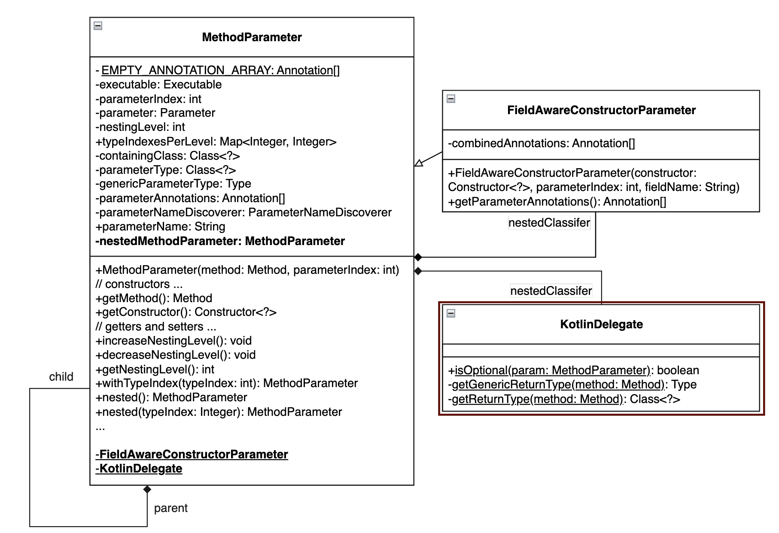
劉玠均 (core.MethodParameter.java)
Encapsulate parameter specification of a “Method” or a “Constructor”.
Inner class: KotlinDelegate To avoid hard dependency on Kotlin at runtime, it applies ReflectJvmMapping to map Kotlin reflection to JVM reflection.
Notes:
ConvertingComparator<S, T>, DefaultConversionService, 8 default converters

Slide 26
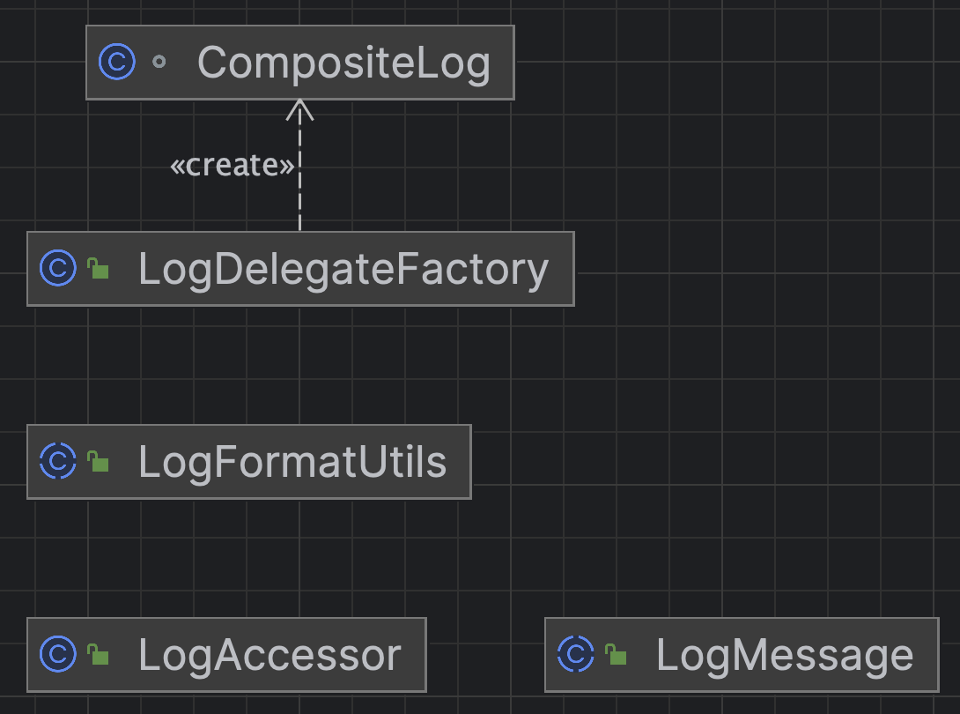
洪世彬
The files on the right side of the UML diagram appear to be extensions based on objects in org.apache.commons.logging, so their relationships may not be immediately evident from the UML diagram.

Slide 27
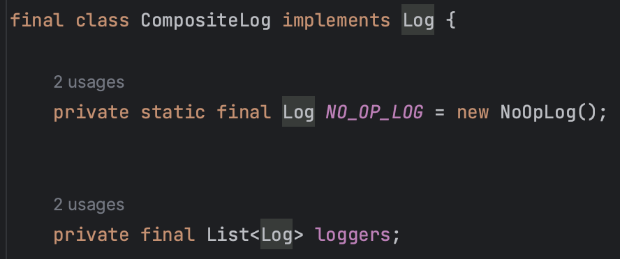
洪世彬
Composite Pattern is used here, as evident from the class names. CompositeLog inherits from the Log interface and contains a List of Log objects internally.

Slide 28
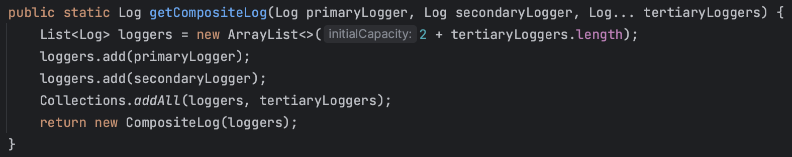
洪世彬
LogDelegateFactory provides a method called getCompositeLog, allowing users to combine multiple Log objects into a single CompositeLog and return it.

Slide 29
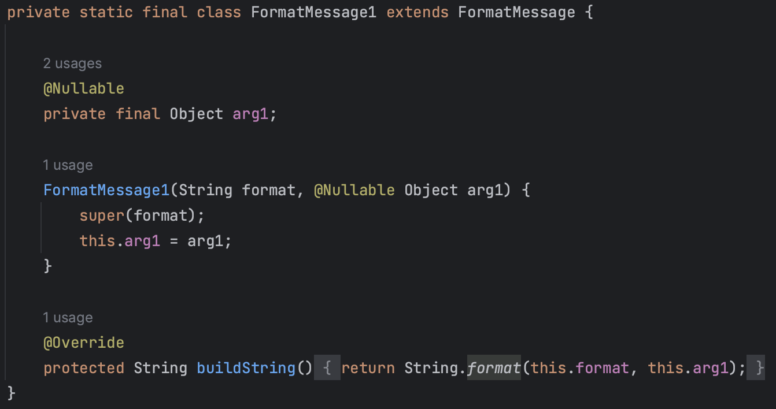
洪世彬
LogFormatUtils offers various utility methods, such as formatValue. And LogMessage provides methods for formatting log content, internally using String.format to achieve this.

Slide 30
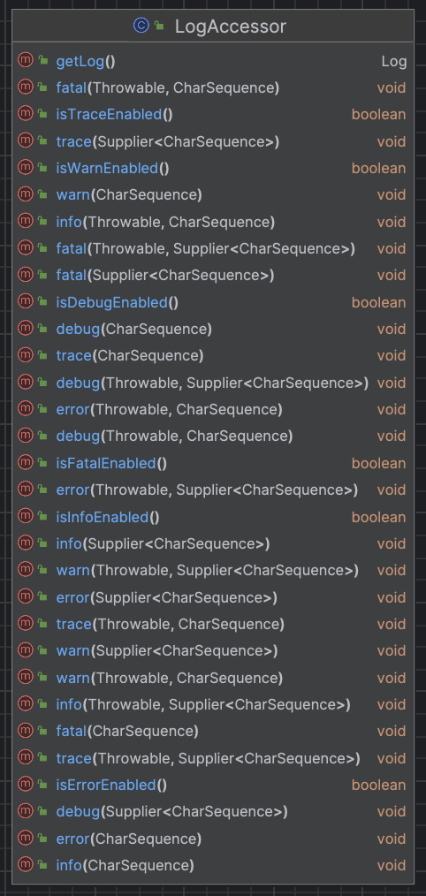
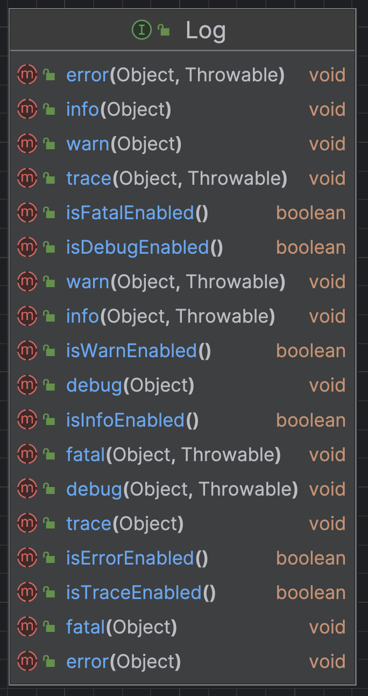
洪世彬
LogAccessor seems to be a convenience wrapper class encapsulating a Log object. It is described as "A convenient accessor for Commons Logging," but its necessity may not be clear since it doesn't seem to reduce the exposed interface from the code's perspective.

Slide 31
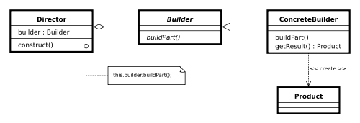
陳君翰
這週看到比較有趣的是 Builder Pattern，在 resource pattern hints, resource bundle hints, type hint, executable hint, etc. 都有
Builder Pattern 適用於創建複雜多變的 Object，單純用 constructor 建造的話需要一次投入大量變數，以至於容易出錯，這時可以設計一個 builder class，可以利用依據需求使用 Builder Class 中的各個 method 來逐步創建目標 Object
以下是 Builder Pattern 的標準做法
Notes:
來源：https://en.wikipedia.org/wiki/Builder_pattern

Slide 32
陳君翰
然而，在本次閱讀的範圍中，沒有任何實作採用標準形式，沒有 director, abstract builder，而是採用 inner class 的方式來創作 builder，例如 ResourcePatternHints.Builder 就會負責建造 ResourcePatternHints
這相當容易閱讀，而原因大概是因為他們並沒有不同 builder 的需求，所以也就不需要把事情複雜化

Slide 33
陳君翰
以簡單範例描述使用 builder 的方法，以ResourcePatternHints為例
不同 class builder 會依據自己的需求建立不同的 method，不一定是下面的 include, exclude
ResourcePatternHints.Builder builder = new ResourcePatternHints.Builder();
builder.include(/* 放入想包含的 resource pattern string */);
builder.exclude(/* 放入想包含的 resource pattern string */);
/* 可以一直使用 include, exclude，直到把東西都設定完後，用 builder.build()完成構建 */
ResourcePatternHints resourcePatternHints = builder.build();

Slide 34
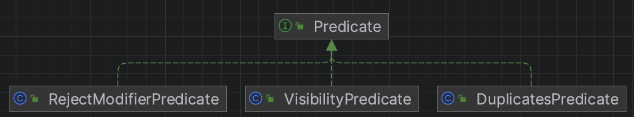
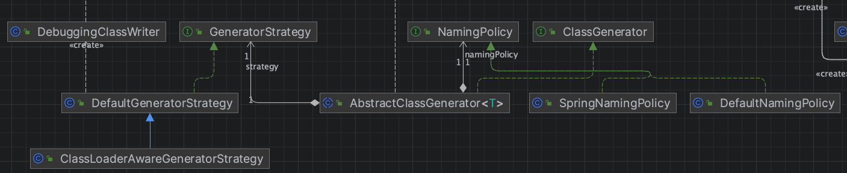
林俊佑
NamingPolicy + GeneratorStrategy + Predicate 3 個抽象都和 AbstractClassGenerator 有關
其中對
NamingPolicy + GeneratorStrategy 兩者使用 Aggregation
Predicate 則是基於 create 的 Association
以下分別描述 3 個抽象的概念
NamingPolicy: 只是字串處理, 封裝了不同 policy 產生 ClassGenerator 動態生成 class 的 name
GeneratorStrategy: 引用拿來生成 class 的 ClassGenerator 內的 generateClass 方法產生 class 的 binary 結果(generateClass 要委派 ClassEmitter) 協助
Predicate: 內含 Predicate 可以輸入 object 決定要不要執行 CGLIB 插入的 CALLBACK, 封裝了不同 object 所需要的不同實作

